Slide 1
Terminologies Related to Caption Generation
by
Prithwiraj Samanta
Under the supervision of
Dr. Rashmi Panda
Department of Computer Science and Engineering
INDIAN INSTITUTE OF INFORMATION TECHNOLOGY, RANCHI
(An Institution of National importance under act of Parliament)
(Ranchi - 834010), Jharkhand

Slide 2
Outline
Introduction ..…………………….. 4
Standard Video Captioning System ……………………….. 5
Deep Neural Network Structure ……………………….. 6
Feature Extraction ……………………….. 9
Feature Fusion …..………………….. 17
Temporal Attention Mechanism ..…………………….. 18
Spatial Attention Mechanism ..…………………….. 19
Channel Attention Mechanism ……………………….. 19

Slide 3
Abstract
Video Captioning is automatic description generation from digital video

Slide 4
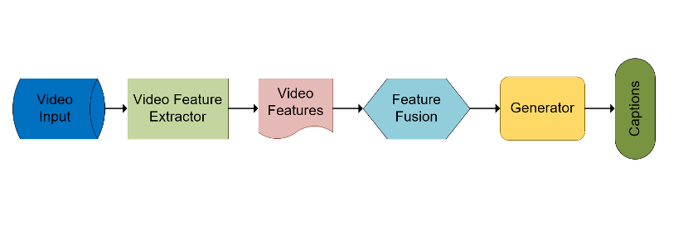
Standard Video Captioning System
Video captioning is a text description of video content generation. Compared with image captioning.
The scene changes greatly and contains more information than a static image.

Slide 5
Deep Neural Network Structure
To start with, multimodal features are extracted from the input video information by feature extractor, and then the fused features are obtained by the feature fusion.
The video features are input into the encoder to get the hidden state coding, and the captions are decoded by the encoder.
Finally, the captions are encoded as reconstruction vectors, and the constraint reconstruction vectors are similar to the fused video features as much as possible.

Slide 6
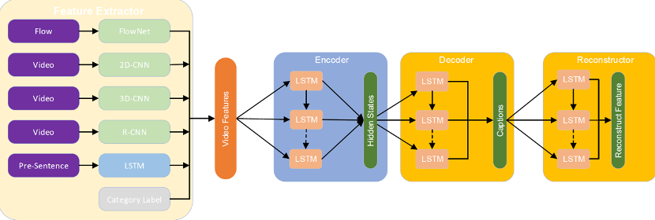
Deep Neural Network Structure

Slide 7
Feature Extraction
Video features can be simply divided into visual features, motion features, auxiliary tag information, audio features.
Theoretically, it includes 2D-CNN features, 3D-CNN features, and semantic features.
When extracting 2D-CNN features of video, a specified number of video frames are sampled from the video.
The sampling method can be random sampling or equal interval sampling.
The obtained video frames are sent to the pre-trained CNN, and the higher activation vectors of CNN are retained as video feature embeddings

Slide 8
Feature Extraction
3D-CNN can perform convolution operation both on the spatial and temporal dimension of the video.
Therefore, the temporal characteristics of the video are well preserved.
Semantic features refer to a large class of features that can capture the semantic content in the video.
It can be categized into spatial semantic information (i.e. object information) and temporal action information.

Slide 9
Feature Fusion
3D-CNN can perform convolution operation both on the spatial and temporal dimension of the video.
Feature fusion refers to fuse the extracted multi-modal features to achieve fixed-length features to be sent to the network.
We can obtain compact representation of integrated features, thus resulting in lower computational complexity and better performance

Slide 10
Temporal Attention Mechanism
In the video, each frame represents the information of different time.
The visual features of each frame are a relatively complete semantic information expression.
It expresses the global temporal information in the video, such as the sequence of objects, actions, scenes and people in the video

Slide 11
Spatial Attention Mechanism
Video contains both global temporal features and local temporal features.
These features are usually the expression of fine-grained features of video for some actions, or fine-grained features for identifying important areas of the image, such as the area where people are in the image

Slide 12
Channel Attention Mechanism
CNN network will produce a different number of feature maps in each layer, namely channel features
Specifically, the low-level feature map shows low-level visual features such as texture and color, while the high-level feature map shows high-level semantic features such as some objects with different spatial features

